Slide 1
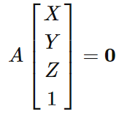
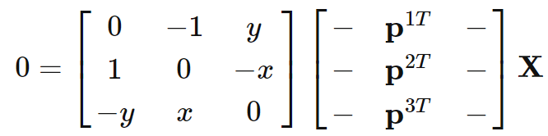
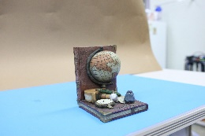
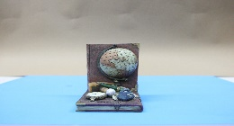
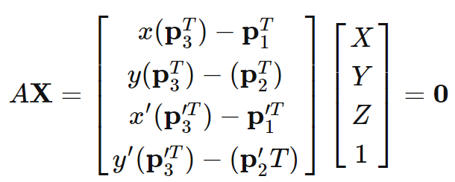









Overall Strategy
1-3. reconstruct 3D points from keypoints from the selected image using triangulation
Reconstruct 3d points of matched keypoints using two camera poses
$$X_{2}$$
$$X_{1}$$
$$X_{3}$$
$${x′}_{2}$$
$$x_{1}$$
$$x_{2}$$
$${x′}_{1}$$
$${x′}_{3}$$
$$x_{3}$$
Cam2
Cam1
See this link for more explanation
Notes:
Here are the details of the whole process:
Let me explain these things slowly.

Slide 2
Overall Strategy
1-3. Detail description about 3D reconstruction using triangulation
You need to create and add 3D points using the new camera pose calculated by 3 points RANSAC
Perform keypoints matching again with the selected image and one of existing images
One of existing image that has a most number of matches with the selected image is recommended
Now you can reconstruct 3D points from 2D keypoints in the selected image using triangulation with the existing one
You should choose good 3D points using thresholding on re-projection error or distance in 3D space
If matched keypoint already has a corresponding 3D point => thresholding on distance in 3D space (threshold = 5e-4)
If matched keypoint doesn’t have corresponding 3D point => reproject that 3D point onto the existing one and threshold it.
Notes:
Here are the details of the whole process:
Let me explain these things slowly.

Slide 3









Overall Strategy
1-3. Detail description about 3D reconstruction using triangulation
You need to create and add 3D points using the new camera pose calculated by 3 points RANSAC
$$X_{2}$$
$$X_{1}$$
$$X_{3}$$
New_image
$${x′}_{2}$$
$$x_{2}$$
$${x′}_{1}$$
$${x′}_{3}$$
$$x_{1}$$
Calculated by RANSAC
$$x_{3}$$
Cam3
Cam2
Cam1
3

Slide 4
Overall Strategy
1-3. Detail description about 3D reconstruction using triangulation
Perform keypoints matching again with the selected image and one of existing images
$$X_{2}$$
$$X_{1}$$
$$X_{3}$$
New_image
$$x_{1}$$
$$x_{2}$$
Calculated by RANSAC
$$x_{3}$$
Cam3
Cam1
Newly matched keypoints
4

Slide 5
Overall Strategy
1-3. Detail description about 3D reconstruction using triangulation
Now you can reconstruct 3D points from 2D keypoints in the selected image using triangulation with the existing one
$$X_{2}$$
$$X_{1}$$
$$X_{3}$$
New_image
$$x_{1}$$
$$x_{2}$$
Calculated by RANSAC
$$x_{3}$$
Cam3
Cam1
Newly matched keypoints
5

Slide 6
Overall Strategy
1-3. Detail description about 3D reconstruction using triangulation
You should choose good 3D points using thresholding on re-projection error or distance in 3D space
If matched keypoint already has a corresponding 3D point => thresholding on distance in 3D space
If matched keypoint doesn’t have corresponding 3D point => reproject that 3D point onto the existing one and threshold it.
$$X_{1}$$
$$X_{3}$$
New_image
$$x_{1}$$
$$x_{2}$$
Calculated by RANSAC
$$x_{3}$$
Cam3
Cam1
Newly matched keypoints
6

Slide 7
Step VI. Optimization
Preparing Data structure for bundle optimization
Provided bundle optimization codes(LM2_iter_dof.m, JacobiancostE.m) enforces some types of data structure.
In order to use the provided code smoothly, you should keep the data structure during growing step that will be specified in following slides
Notes:
Bundle Adjustment calculates the reprojection error with the matching 2d pixel after projecting all 3d points observed by the camera.
After that, the pose and 3d points are optimized by calculating the gradient in a way that minimizes it.
Repeat this several times until convergence.
Bundle Adjustment는 카메라에서 관측된 모든 3d points들을 사영 시킨뒤, 이에 매칭된 2d pixel과의 reprojection error를 계산합니다.
이후 이를 최소화 하는 방식으로 gradient를 계산하여 pose와 3d points를 최적화 합니다.
이를 수렴할때까지 여러번 반복합니다.

Slide 8
Step VI. Optimization
[x_BA] = LM2_iter_dof(x, param) (LM2_iter_dof.m)
Takes 2 arguments; x, param
x is a serialized variable of rotation vector, translation vector and 3D points.
Not rotation matrix, rotation vector
Shape of x should (n, 1) with elements….
[(sfm00’s rotation vector),(sfm00’s translation vector) …(sfm14’s rotation vector),
(sfm14’s translation vector), (flattened 3D points)]
x
Camera poses
3D points
Notes:
Bundle Adjustment calculates the reprojection error with the matching 2d pixel after projecting all 3d points observed by the camera.
After that, the pose and 3d points are optimized by calculating the gradient in a way that minimizes it.
Repeat this several times until convergence.
Bundle Adjustment는 카메라에서 관측된 모든 3d points들을 사영 시킨뒤, 이에 매칭된 2d pixel과의 reprojection error를 계산합니다.
이후 이를 최소화 하는 방식으로 gradient를 계산하여 pose와 3d points를 최적화 합니다.
이를 수렴할때까지 여러번 반복합니다.

Slide 9
Step VI. Optimization
[x_BA] = LM2_iter_dof(x, param) (LM2_iter_dof.m)
Param is a dictionary that contains keypoints, indices, etc for optimization.
Here are keys and values that should be included
K: intrinsic matrix
uv: a “list” that contains numpy arrays.
each numpy array has shape of (4, N) where N can be vary.
Each column of numpy array is [keypoints_coordinates, 1, corresponding 3D point index] => total 4 elements
The “corresponding 3D points index” is a value that tells which 3D point the keypoint corresponds to. For example, if it is 1200, it means that the 3D point corresponding to this keypoint is the 1200th one in the 3D point array.
So you need to keep track of which 3D point the keypoint matches during the growing step.
Notes:
Bundle Adjustment calculates the reprojection error with the matching 2d pixel after projecting all 3d points observed by the camera.
After that, the pose and 3d points are optimized by calculating the gradient in a way that minimizes it.
Repeat this several times until convergence.
Bundle Adjustment는 카메라에서 관측된 모든 3d points들을 사영 시킨뒤, 이에 매칭된 2d pixel과의 reprojection error를 계산합니다.
이후 이를 최소화 하는 방식으로 gradient를 계산하여 pose와 3d points를 최적화 합니다.
이를 수렴할때까지 여러번 반복합니다.

Slide 10
Step VI. Optimization
[x_BA] = LM2_iter_dof(x, param) (LM2_iter_dof.m)
Param is a dictionary that contains keypoints, indices, etc for optimization.
Here are keys and values that should be included
nX: the number of 3D points that are reconstructed
key1 and key2: indices of images that are reconstructed for the first time; in this case key1 is 4 and key2 is 5
(matlab index start at 1)
Optimization: 1
Dof_remove: 0
Notes:
Bundle Adjustment calculates the reprojection error with the matching 2d pixel after projecting all 3d points observed by the camera.
After that, the pose and 3d points are optimized by calculating the gradient in a way that minimizes it.
Repeat this several times until convergence.
Bundle Adjustment는 카메라에서 관측된 모든 3d points들을 사영 시킨뒤, 이에 매칭된 2d pixel과의 reprojection error를 계산합니다.
이후 이를 최소화 하는 방식으로 gradient를 계산하여 pose와 3d points를 최적화 합니다.
이를 수렴할때까지 여러번 반복합니다.

